Slide 1
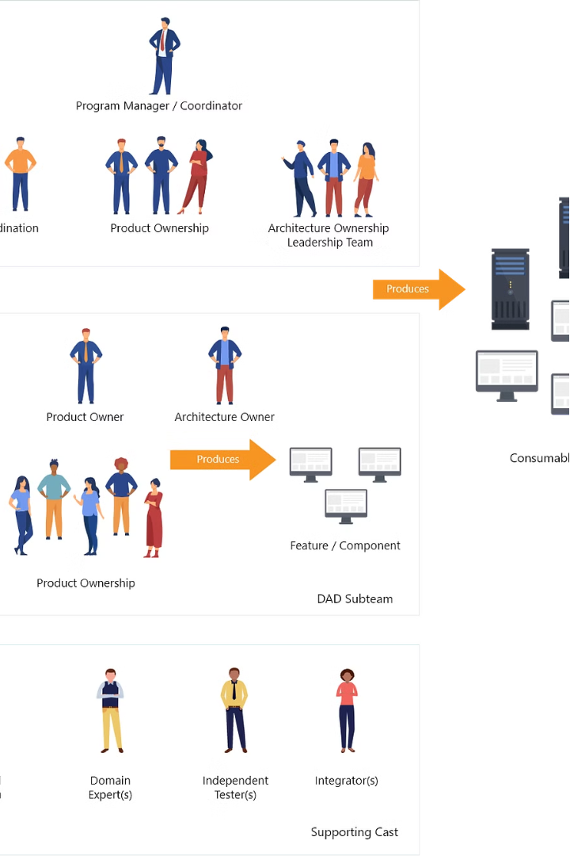
Agile and Scrum Process Workflow
Navigating Project Success with Agile Methodologies
Agile and Scrum are powerful frameworks that empower teams to deliver projects with speed, flexibility, and customer focus.
Shubham Singh Soragi

Slide 2
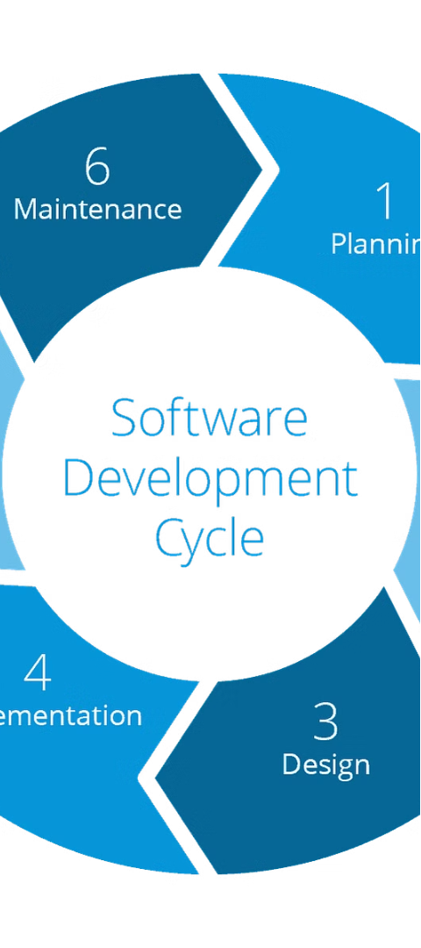
Defining Agile
1
Iterative Approach
Agile focuses on delivering projects in small, incremental iterations rather than a single, large release.
2
Customer Value
The goal is to continuously provide value to customers throughout the project lifecycle.
3
Flexibility
Agile embraces change and allows teams to adapt to evolving requirements and market demands.

Slide 3
Introducing Scrum
Collaborative Framework
Sprints and Iterations
Flexibility and Transparency
Work is completed in short, time-boxed cycles called Sprints, enabling rapid feedback and iterations.
Scrum emphasizes teamwork, communication, and adaptability to tackle complex projects.
Scrum promotes transparency and the ability to respond to change, fostering project success.

Slide 4
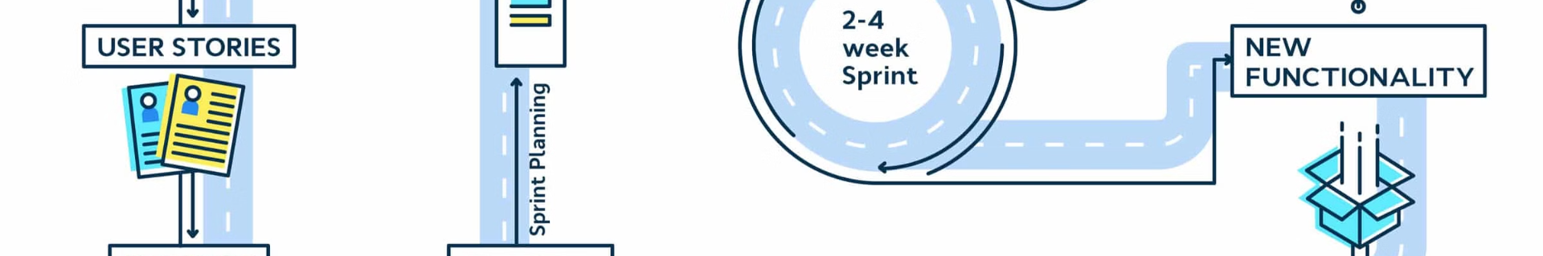
Sprint Planning in Scrum
Define Goals
Assign Responsibilities
The team collaboratively defines the sprint goals and objectives.
The team assigns tasks to individual members based on their skills and availability.
1
2
3
Estimate Tasks
The team estimates the effort required to complete each task in the sprint backlog.

Slide 5
Project Initiation and Planning
Define Project Scope
Identify Stakeholders
Clearly outline the project objectives, deliverables, and constraints.
Engage with key stakeholders to understand their needs and expectations.
Create a Product Backlog
Establish Sprint Cadence
Develop a prioritized list of features and requirements to be implemented.
Determine the duration and frequency of the project's Sprints.

Slide 6
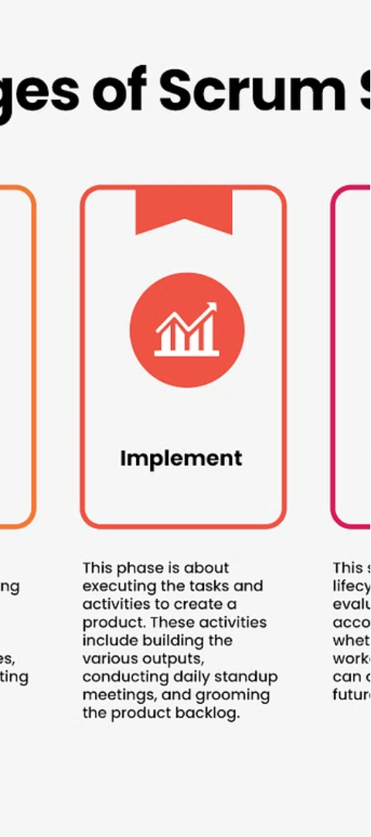
Sprint Planning
1.
Review Backlog
The team reviews the prioritized product backlog to select the highest-priority items for the upcoming sprint.
2.
Estimate Capacity
The team estimates their collective capacity and availability for the sprint.
3.
Commit to Tasks
The team commits to the sprint backlog and plans how to accomplish the selected tasks.

Slide 7
Sprint Execution
Daily Standups
Sprint Backlog
Sprint Review
Sprint Retrospective
Brief, daily meetings to share progress, identify blockers, and coordinate team efforts.
A prioritized list of tasks the team has committed to completing during the sprint.
A meeting to demonstrate the completed work and get feedback from stakeholders.
A meeting to reflect on the process, identify improvements, and plan for the next sprint.

Slide 8
Agile and Scrum Benefits
Increased Flexibility
Ability to adapt to changing requirements and market conditions
Faster Time to Market
Rapid delivery of working software through short, iterative cycles
Improved Collaboration
Frequent communication and cross-functional teamwork
Enhanced Customer Satisfaction
Continuous delivery of value and incorporating customer feedback

